Slide 1


GITAVERSE
Bridging Ancient Wisdom with Modern Living
Team Name - MADHAVAS
Anurag Salvi
Bhanushree Chundawat
Deepanshu Kumawat
Himanshu Joshi
Monish Soni
Yash Kumar Gupta
20ETCCS008
20ETCCS016
20ETCCS026
20ETCCS053
20ETCCS075
20ETCCS117
Techno India NJR Institute of Technology, Udaipur (Rajasthan)
Computer Science & Engineering Department

Slide 2

WHY Gitaverse
Incorporate logical and rational analysis of the Bhagavad Gita's teachings to enhance understanding and critical thinking skills.
Benefit from a dedicated team of IITians, ensuring top-notch education and guidance throughout our course.
Gain practical insights and real-world applications, enhancing your understanding of the subject matter within our comprehensive course.
Bridge the gap between science and spirituality, fostering a holistic understanding, in-depth knowledge.
Experience personalized mentoring for individualized growth, support, and guidance on your spiritual journey.

Slide 3
OBJECTIVE & SCOPE
Integrate Bhagavad Gita's teachings with science.
Provide a holistic journey into spirituality through science-backed insights.
Global accessibility to Science + Scripture courses.
Thematic Introduction to Bhagavad Gita for practical application.
Foster cultural awareness and parental involvement for holistic growth in children.
Offer courses on Understanding God from Science, Like - The science of the soul, and Vedic solutions

Slide 4
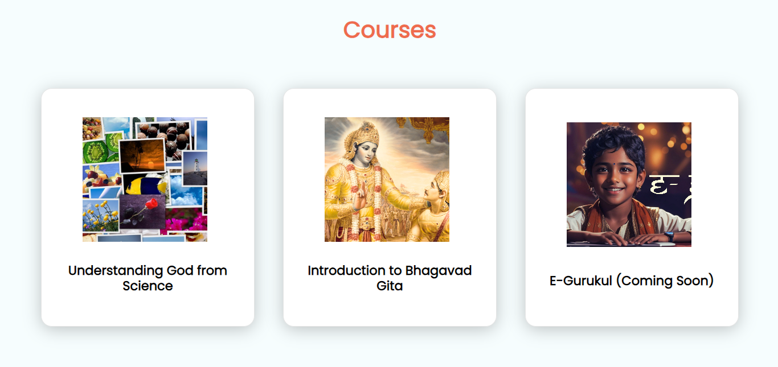
Courses we provide

Slide 5
Benefits of Gitaverse
Holistic Education
Global Connectivity
Personal Development Camps
Mental Well-being Hub
Leadership Empowerment
Lifestyle Transformation
Educational Resource Hub
Offering 1:1 discussions, guidance, and decoding scriptures.

Slide 6

Technology stack
Design - Figma
Frontend - React JS
Backend - Express JS, Node JS
Build & Tooling - Vite JS
Database - MongoDB

Slide 7
Our Future Vision
Develop Blog Page and we’ll rank it over Google.
We will move to other prominent social media platform after getting stabilized on Instagram.
Regularly updating website with trending features by website by taking feedback of peoples.
Regular development of the course content plus website and social media related content also.
We will develop an YouTube channel for properly propagating our philosophy and branding our platform.

Slide 8
Thank You!

